Slide 1
Team Bits N’ Bytes
Team Members –
Lavnika Markande
Garima Mandavi
Janbhi Sharma
Sajal Sharma

Slide 2
Edutech - Problem Statement
Transforming learning into Amazing e-learning Experiences.
Lack Of Learner Motivation And Engagement.
Staying Up-To-Date With Modern Tech.
Designing e-learning Courses For Different Generations.
Measurable learning outcomes.
Adaptive learner models to accommodate different learner needs.

Slide 3

SOLUTION
We have built an e-learning website which can be used by students to get their subject study material in text and video format.
The study material will be interactive to ensure maximum interest and participation in the students.
In addition to this the website also features a discussion forum where students can discuss any topic with each other.

Slide 4
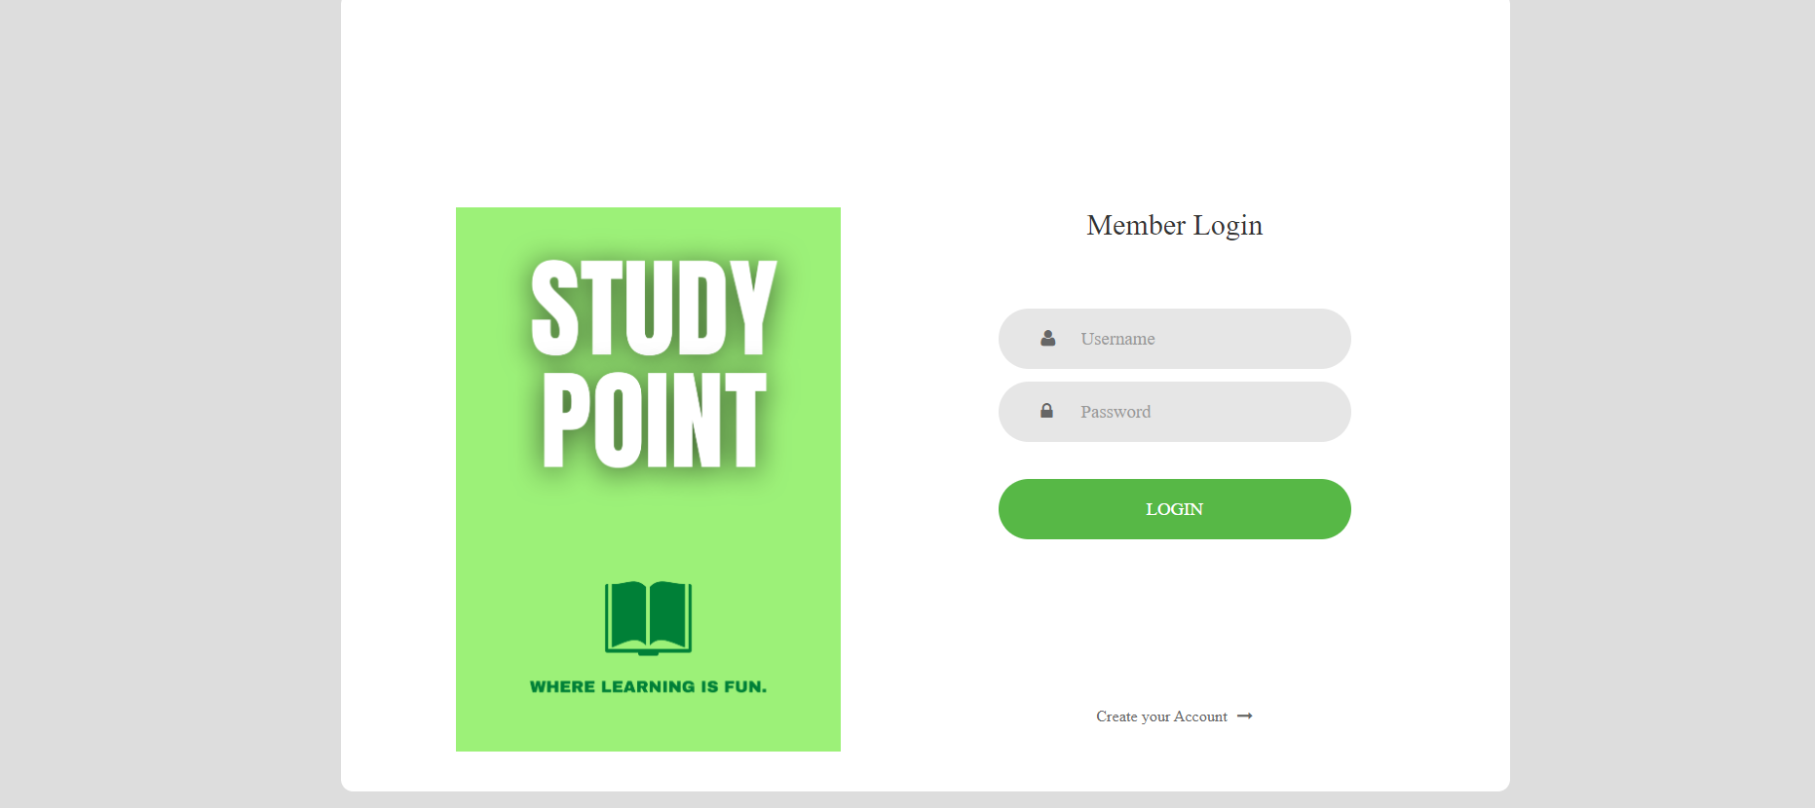

Slide 5
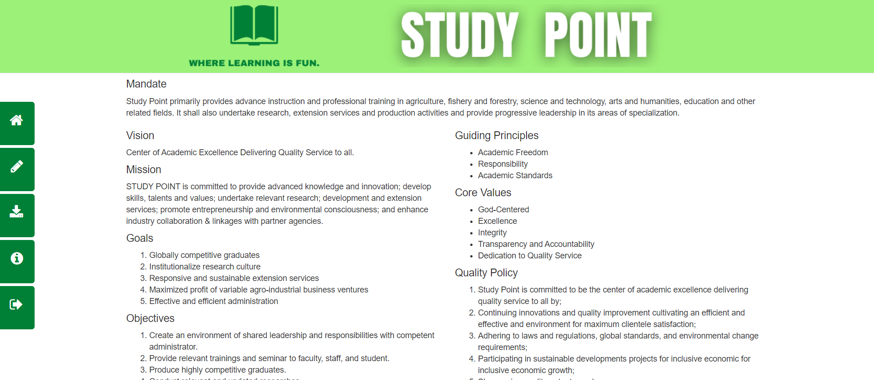

Slide 6
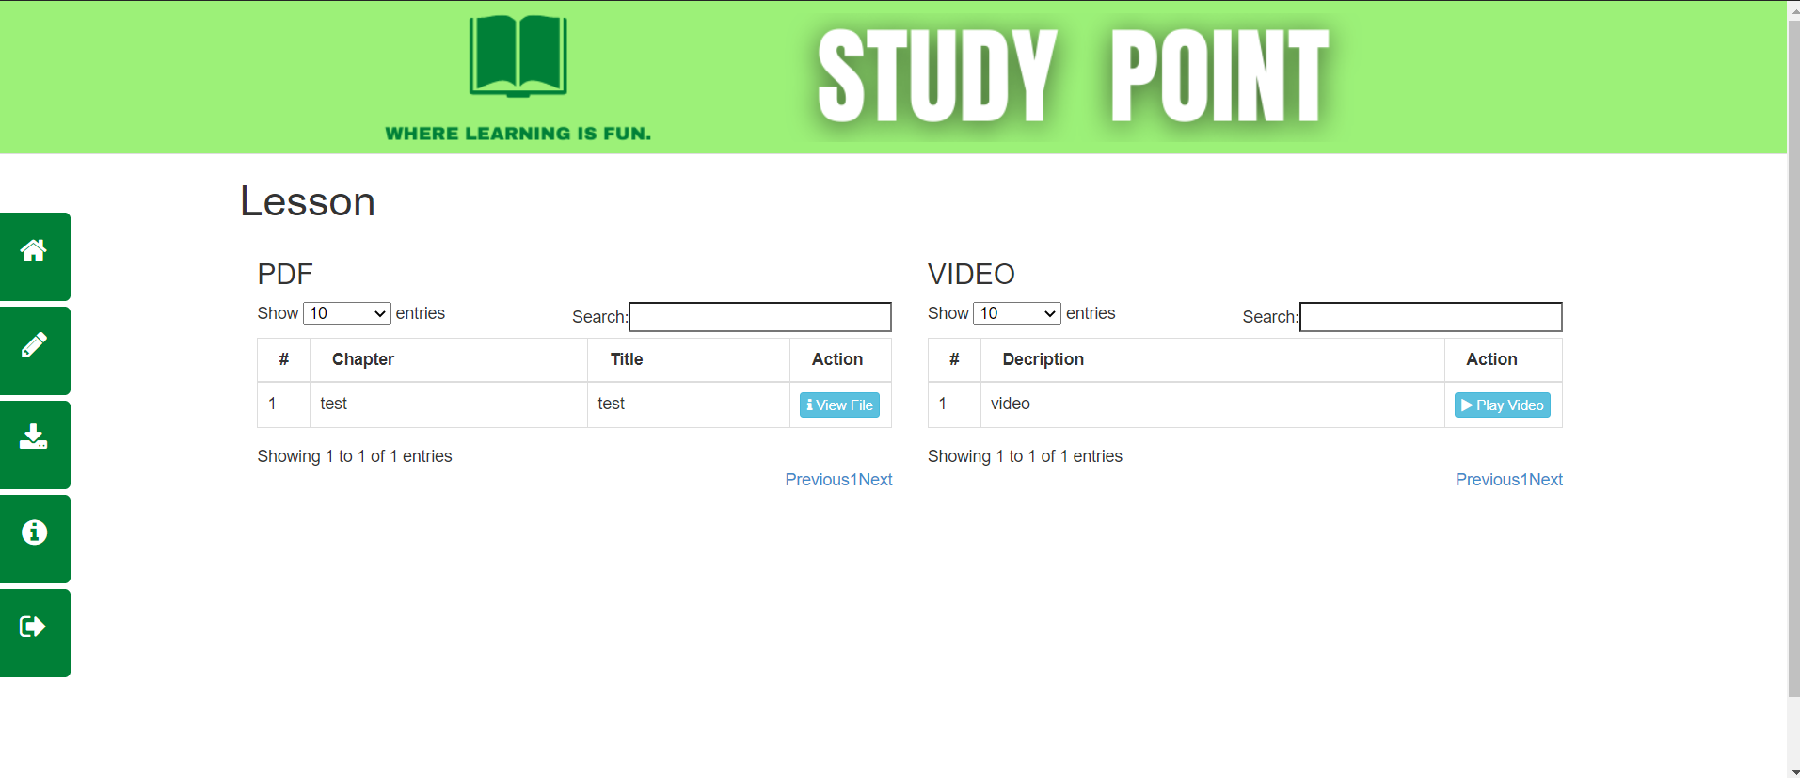

Slide 7
Tech Stack
HTML
CSS
JavaScript
PHP
MySQL

Slide 8
THANK YOU

